Slide 1

Airline Reservation System

Slide 2

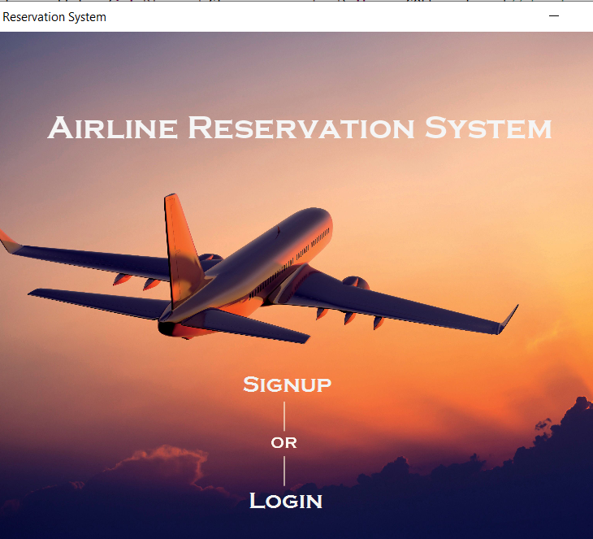
Scene Home
Signup and Login for Customer
More menu that includes Admin login and Exit

Slide 3
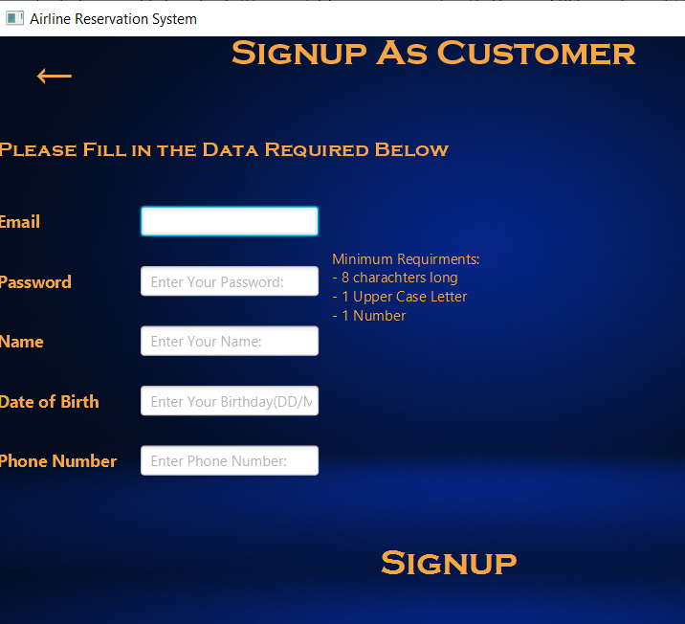
Scene Signup
Signup As Customer
Requires a valid Email
Password that meets the requirements
Name letters only

Slide 4
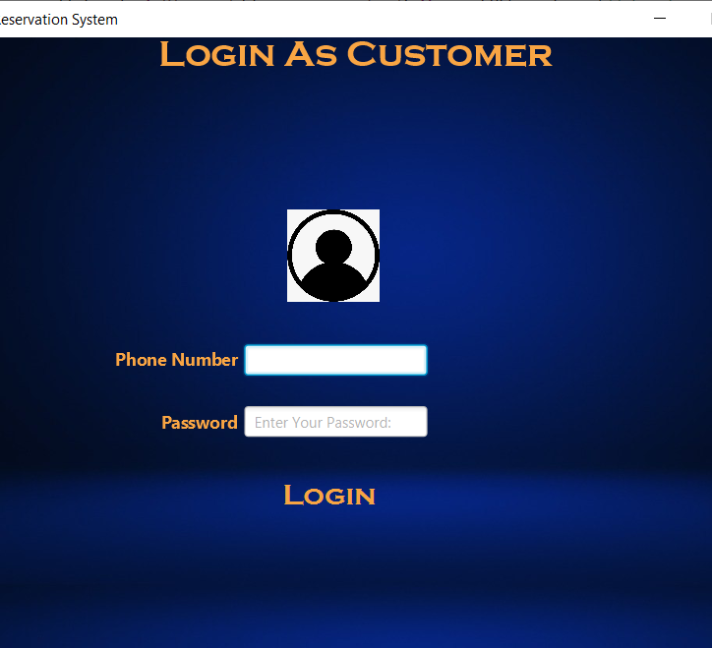
Scene Login
Login As Customer
Checks the phone number and the password of the Customer saved in database

Slide 5
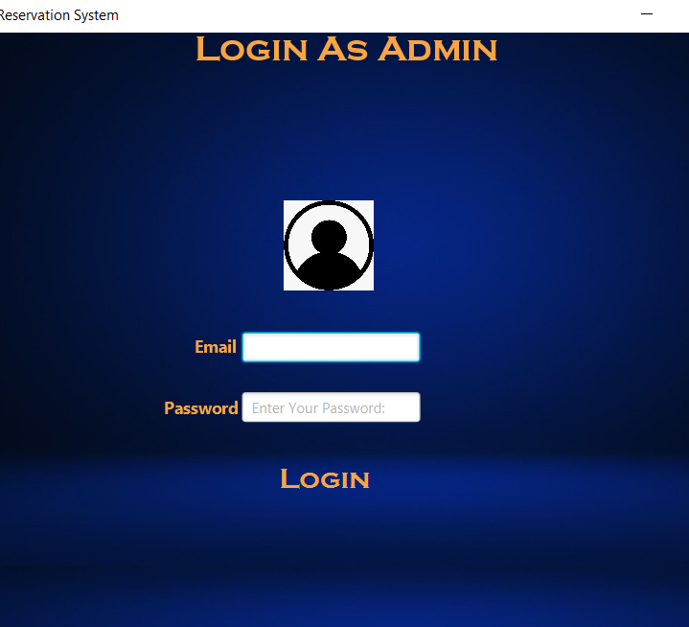
Scene Admin Login
Login As Admin
Checks the Email land the Password of the Admin saved in database

Slide 6
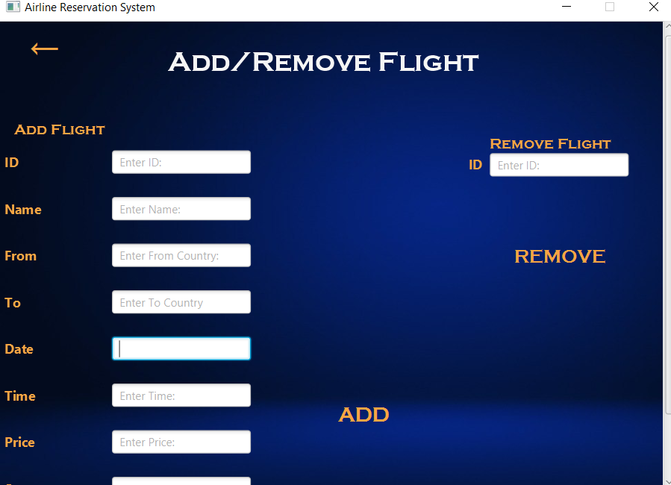
Scene Add/Remove Flight
Adds the information of the new flight in the database
Remove Flight by id

Slide 7
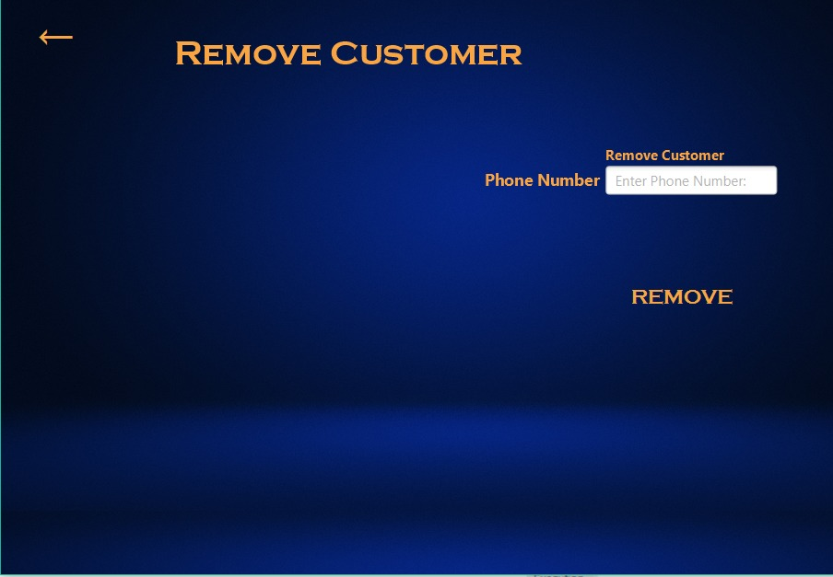
Scene Remove Customer
Remove Customer by phone number

Slide 8
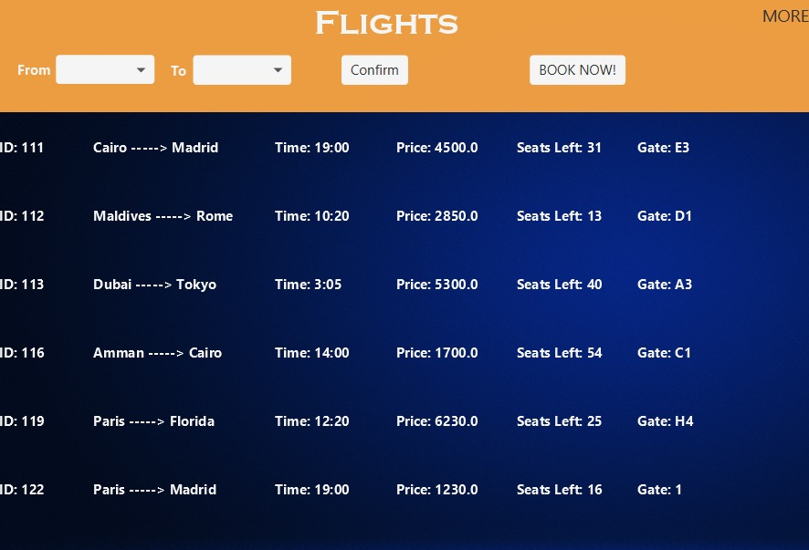
Scene Flights
View all available Flights
Flight filter with the from and to location
Book now to go to seene Booking

Slide 9
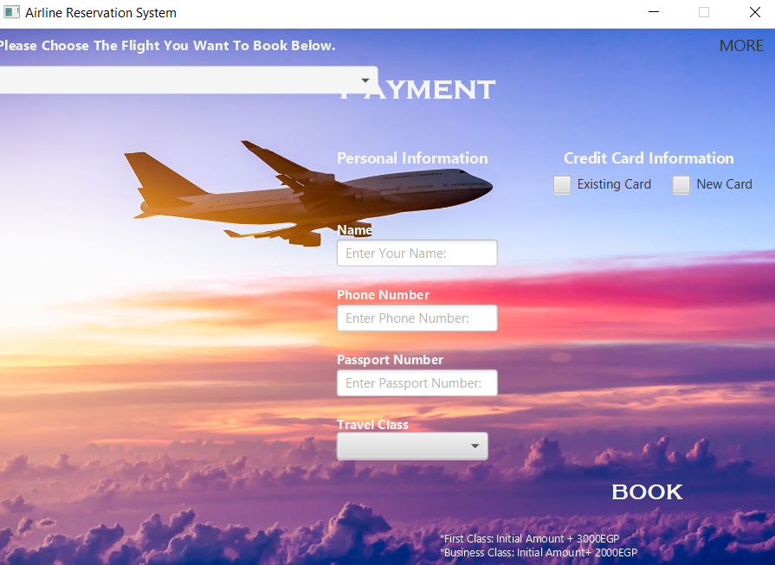
Scene Booking
Choice box with all the available flights
Personal Information for the ticket
Credit Card payment Either Existing or new

Slide 10
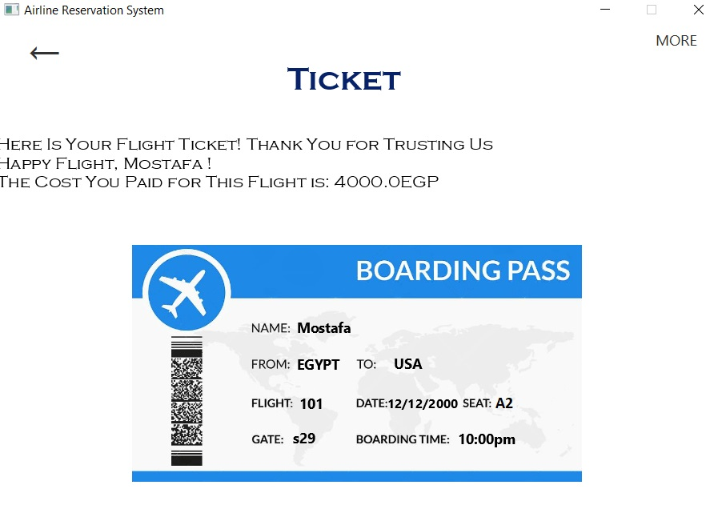
Scene Ticket
View The Cost Paid
View Boarding Pass Ticket

